Slide 1
Budgeted-Constrained Screening for HDP
Data Science Home Assignment
Olga Rapp Lerner
September 2025

Slide 2
Budgeted Gestational Week-15 Triage: Refer the Top-K for Confirmatory Labs
Goal: Rank patients by risk at gestational week 15 and refer the Top-K under a fixed budget K = B× N
Cohort: Low/moderate-risk pregnancies only, high-risk auto-referred and excluded from the dataset
Success at budget:
Recall at K ≥ budget % (random selection baseline)
Precision at K ≥ prevalence (N = 10,000, Positives = 432 , Prevalence = 4.32%)

Slide 3
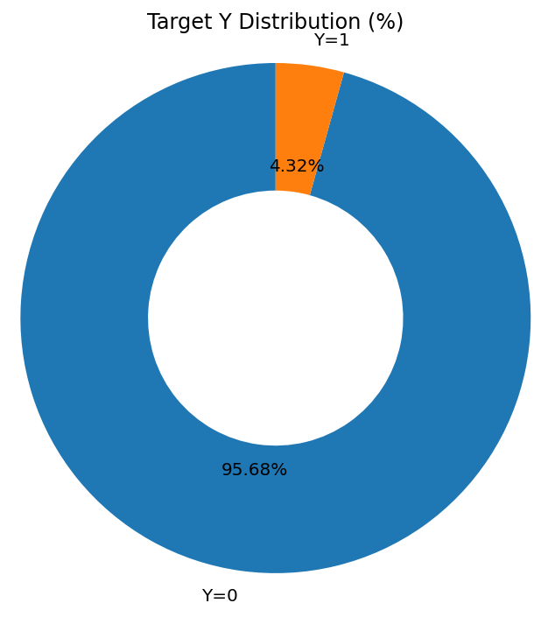
Data Overview
Cohort: N=10,000, low/moderate-risk pregnancies. High-risk auto-referred were excluded.
Target prevalence: 4.32% (Y=1, 432 of 10,000)
Working table shape: 10,000 × 155 (~61.1 MB).
Data types: numeric labs/BP summaries + a few categorical; one long clinical_text column
Task 1: Data Exploration

Slide 4
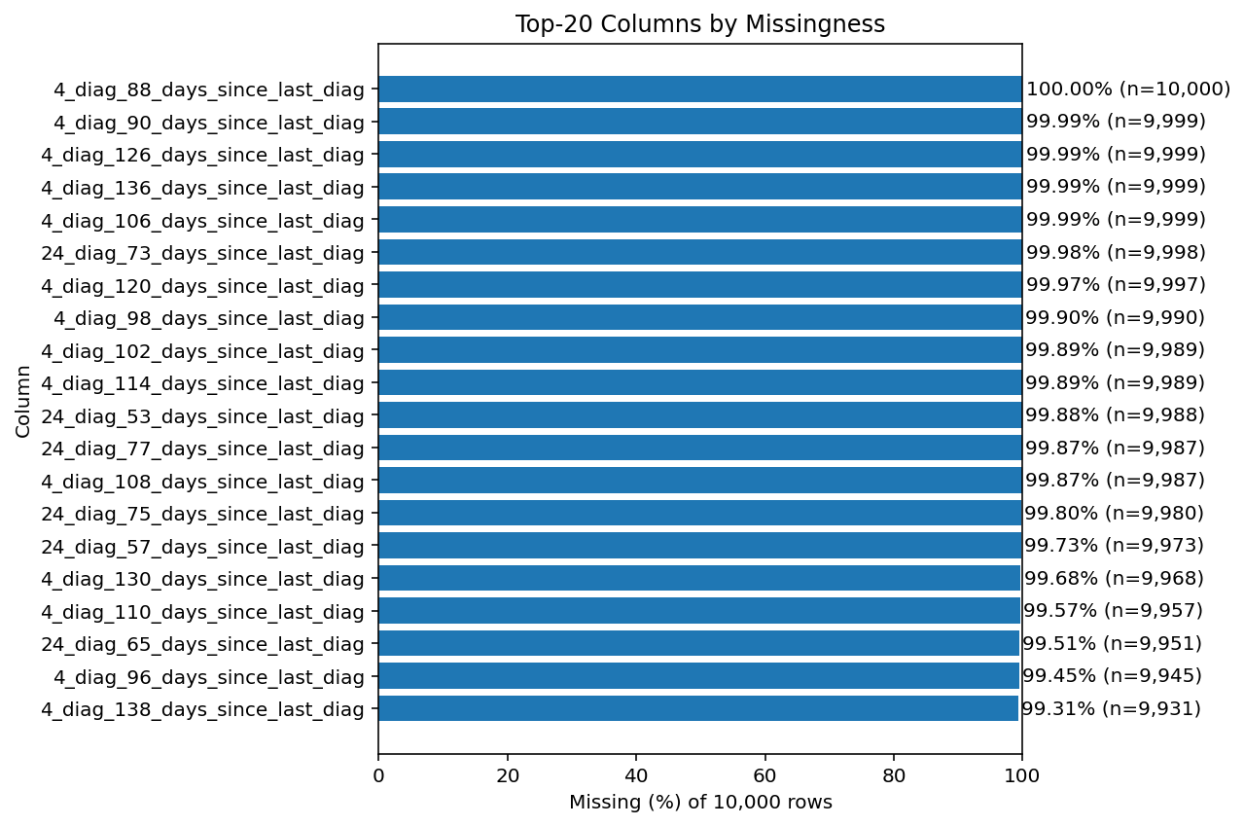
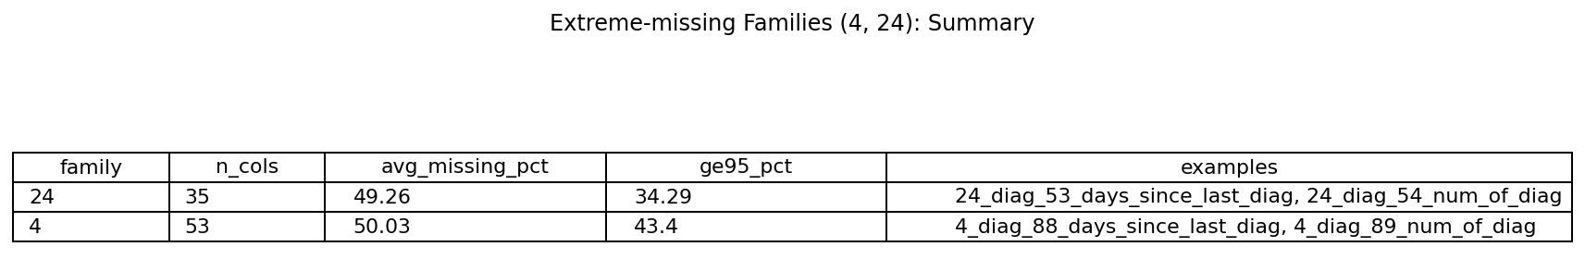
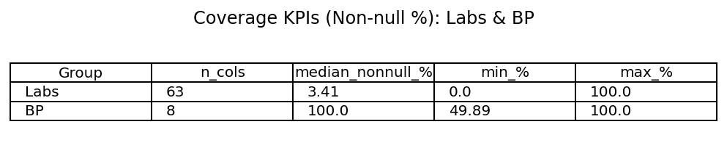
Missingness and Coverage - What Enters the Model
Quality of the data, what we drop vs. what we keep
Long-lookback families (4_*, 24_*) are >95–99% missing → excluded from modeling (logged in drop report).
Core signals (BP summaries, Protein-U, PLT, key CBC: WBC/HGB/HCT/RDW/MPV, Age/SES) show usable coverage → median impute numeric only.
Leakage kept out: match_*, *_sum, labs_sum, clinical_text.
Task 1-2 (EDA, Feature Engineering )

Slide 5
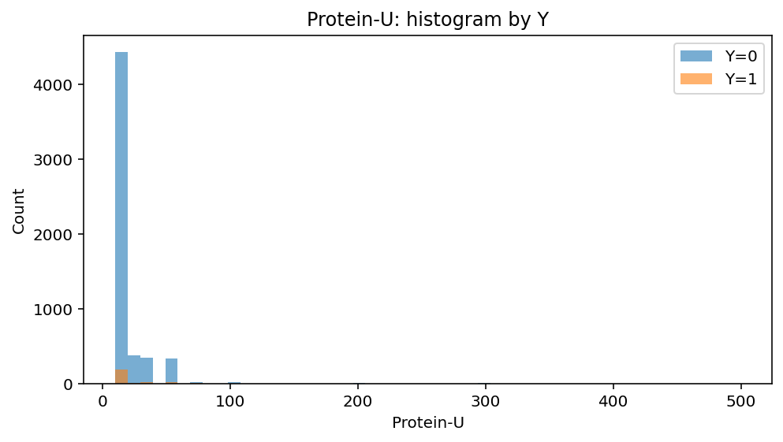
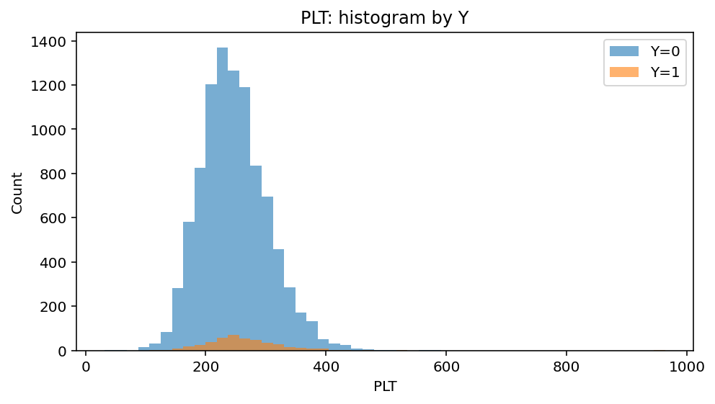
Clinical Signals that Separate Risk
Protein-U and PLT
Protein-U: Concentrated near zero with a long tail; values above a small cutoff have a higher Y=1 rate.
PLT: Bell-shaped (center ≈220–280). No enrichment in lowest decile, slight increase at higher values.
Protein-U ≤ 10.00 (Q2): N=4422.0, P(Y=1)=3.91% • > 10.00: N=1335.0, P(Y=1)=3.97% • Δ=0.06 pp
PLT ≤ 181 (Q10): N=1027.0, P(Y=1)=2.82% • > 181: N=8960.0, P(Y=1)=4.49% • Δ=-1.66 pp
Concentrated near zero with a long tail; non-zero values show only a very small increase in Y=1 on this split
This supports no enrichment at the lowest decile and slight increase at higher values.
Task 1-2, EDA to key signals

Slide 6
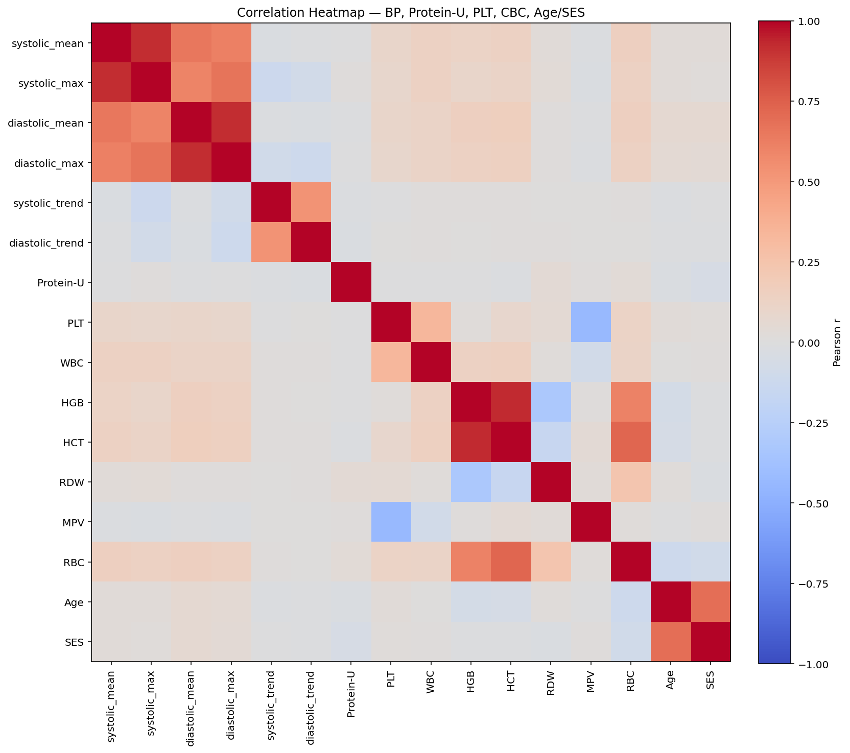
Correlation among BP, Protein-U, PLT, CBC, Age and SES
BP means/max/trends are highly correlated → keep a compact set
Protein-U and PLT are weakly correlated with CBC → complementary
Use this to define the kept feature list for modeling
Task 1-2 (EDA to key signals)
Pearson r; pairwise complete observations

Slide 7
Feature Engineering Summary
Kept or dropped, with rationale
Kept: BP mean/max/trend. Core CBC (WBC, HGB, HCT, RDW, MPV, RBC, PLT, lymphocyte/neutrophil parts). Protein-U, Age, SES. Median-imputed and standardized.
Derived: BP trend (last–first), simple first/last summaries, exact-duplicate columns removed (hash check).
Dropped: match_*, *_sum (incl. labs_sum) and clinical text (post-outcome leakage at week 15), ultra-sparse families 4_* and 24_* (>95–99% missing).
Train and validate: 80/20 stratified split, class imbalance handled via balanced modeling, evaluate at fixed budgets using cases captured at K and positive rate among those tested.
Task 2 (Feature Engineering)

Slide 8
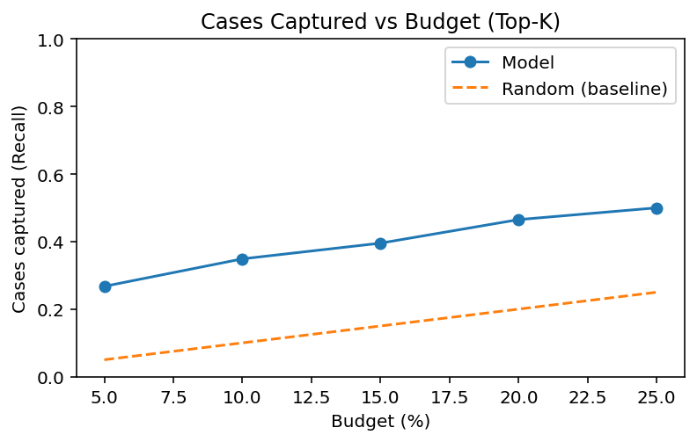
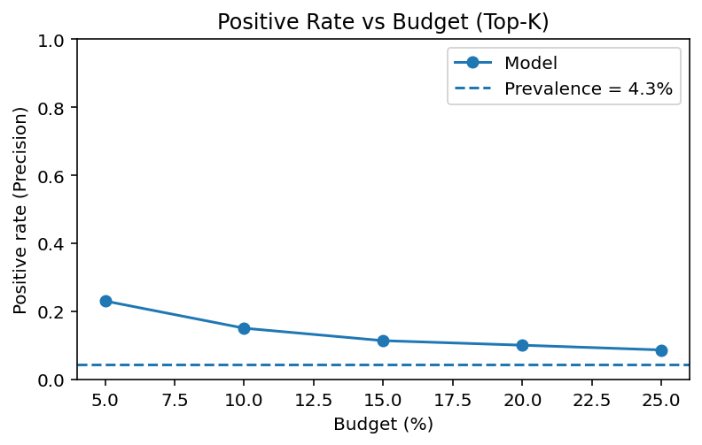
Pipeline and Success at Fixed Budget - Top-K
Pipeline: Median imputation, standardization, and a classifier (logistic regression or tree) trained with an 80/20 stratified split.
Inputs: Remove leak-prone features (match_*, *_sum, labs_sum, clinical_text) and use standardized labs, BP summaries/trends, and Age/SES.
Baselines: With testing budget B% (so K = B% × N), random selection captures ≈B% of all true cases and yields a positive rate equal to cohort prevalence p.
Success: At the same K, the model is effective if cases captured ≥ B% and the positive rate among those tested ≥ p on the holdout set.
Operating point: Set B% from capacity, compute K = B% × N, and evaluate the cases captured and positive rate curves at that K to decide.
Task 2-3-4 (pipeline & success metric)

Slide 9
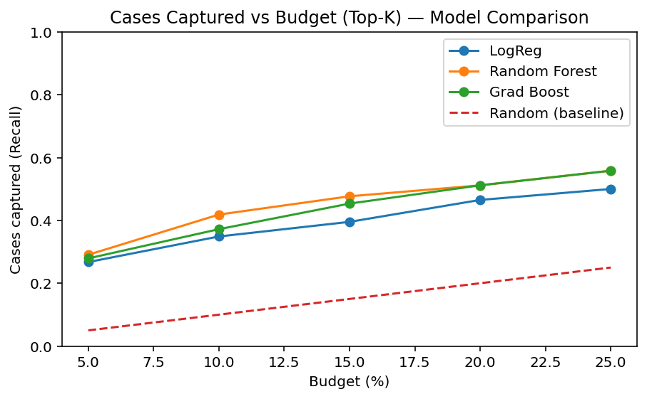
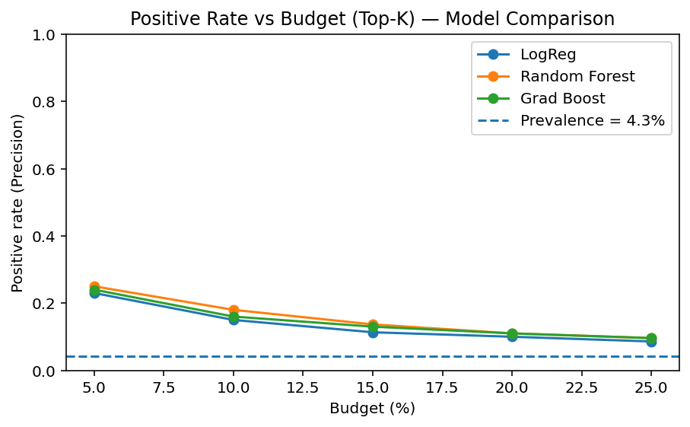
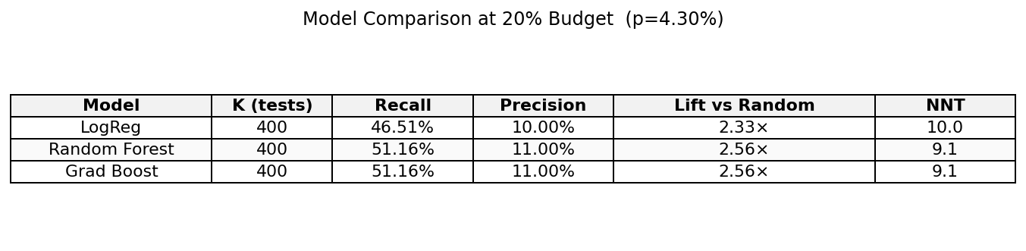
Model Comparison Across Budgets
At 20% budget: Random Forest and Gradient Boost capture ~51% of true cases at ~11% PPV (≈2.6× prevalence).
Precision: All models stay well above prevalence (~4.3%) across budgets.
Choice: Select Random Forest at the operating budget that ties with GB on performance, wins on stability/interpretability.
Adopt Random Forest at a 20% testing budget: ~51% cases captured, ~11% PPV, ~9–10 tests per true case
Task 3-4 (Fixed-budget triage decision)

Slide 10
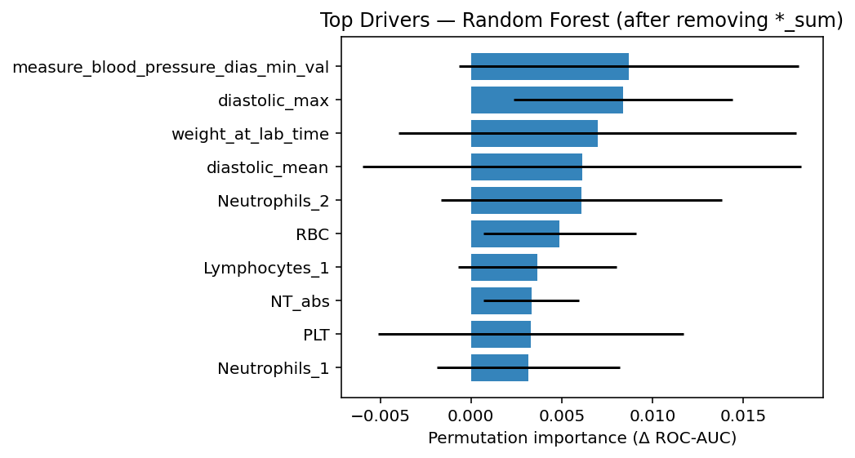
What Drives Risk: Global Feature Influence
BP leads: Diastolic minimum, maximum, and mean are the top contributors on holdout.
CBC adds lift: Neutrophils, RBC, lymphocytes, and platelets contribute meaningful signal.
Secondary signals: Weight at lab time and NT absolute add small, consistent gain.
Distributed influence: Importances are modest (~0.005–0.012 ΔROC-AUC), indicating multiple clinical drivers rather than diagnosis counts.
Sanity check: All “*_sum” diagnosis/count fields and any “match/after” flags were excluded; columns with no observed values were dropped.
Task 5 – Interpretation & Recommendations

Slide 11
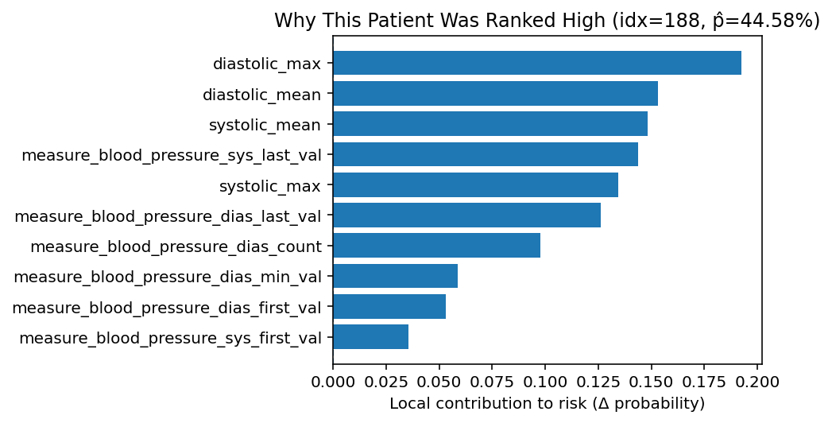
Why This Patient Was Ranked High: Local Explanation
Risk ≈ 45%, driven primarily by blood-pressure features.
Diastolic max and mean are the largest contributors, with systolic mean and max reinforcing elevated risk.
Persistence: last systolic and last diastolic remain high.
Course: first/min diastolic, first systolic, and reading count indicate sustained elevation.
Task 5 – Interpretation & Recommendations

Slide 12
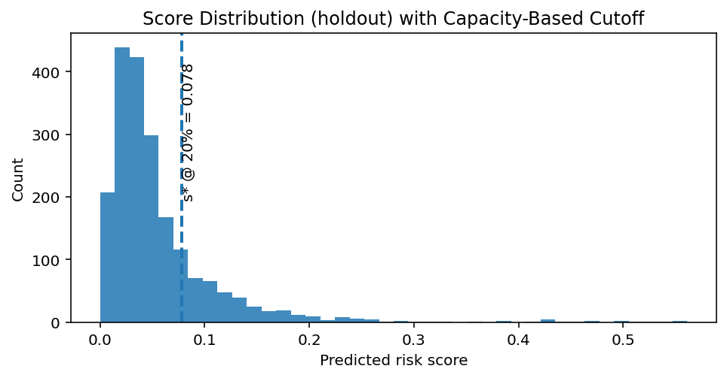
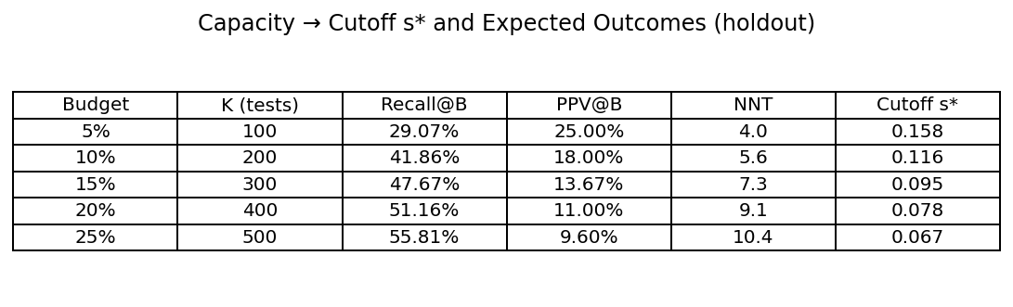
Score Cutoff and Expected Outcomes by Capacity
Capacity rule: top 20% by score → cutoff ≈ 0.078.
Distribution: strongly right-skewed (many low-risk, small high-risk tail).
At 20%: Recall ≈ 51%, PPV ≈ 11%.
Tunable: cutoff moves with capacity (5%–25%).
Random Forest, holdout
Holdout set; prevalence ≈ 4.3%
Task 5 – Interpretation & Recommendations

Slide 13
Recommendation and Operational Guardrails
Adopt: Use Random Forest at a 20% testing budget. Expected recall is about 51%, positive predictive value about 11%, number needed to test about 9-10.
Decision rule: Rank patients by predicted risk each week at gestational week 15 and refer the top K patients. K is 20% percent of the eligible cohort.
Handoff: Include the predicted score and the top 3-5 drivers for each referral, for example blood-pressure mean and maximum, first and last readings, trend, Protein-U, and platelets.
Clinical guardrails: Define automatic referral thresholds for very high blood pressure, define do-not-refer exclusions and contraindications, and allow a documented manual override.
Monitoring: Track recall at the chosen budget, positive predictive value, number needed to test, referral volume, and calibration. Review monthly and recalibrate quarterly or when prevalence changes.
Fairness and governance: Report recall and positive predictive value by age and socioeconomic status, investigate gaps larger than 5 percentage points, and adjust as needed.
Rollout: Run a pilot for 4-6 weeks in shadow or limited volume, tune the cutoff, then go live with versioned change control. Plan to retrain twice per year or after major data changes.

Slide 14

Thank you

